Slide 1
The Internet, Servers, and You
A love story by Rich Winslow
Srsly?

Slide 2


The Internet
Your App
Important Stuff Happens Here
https://www.youtube.com/watch?v=iDbyYGrswtg

Slide 3

The Internet (An overview)
Some Device
The Request
The Response
When you go to a website, you’re actually requesting that some application somewhere serves you the page you want
Most of the magic that happens between your device and that application is routing and figuring out how to deal with your request
We’ll deal with what happens in your web app later on
Magic
a.k.a.
Namecheap
AWS
NGINX
Gunicorn
Your Application

Slide 4
WTF is the Magic?
Namecheap
Domain registrar
First point of contact to your site
Controls the domain name
Translate the domain name to an IP address by talking to a domain name server (DNS)
Pushes the request along to the right address
Amazon Web Services
Web server
Where your application is stored
There’s a portion of a computer (with a hard drive) somewhere in their server farm with space you own and control
It receives the request and figures out what to do with it
NGINX + Gunicorn
Server processes
NGINX is an interface to deal with all incoming requests to your server
Gunicorn is the interface to take that request and send it to your Flask application
Both pieces are required
The Response
Your Application
The Request

Slide 5



You can think of it like real estate
Namecheap
The street address
Amazon Web Services
The plot of land (with utilities)
NGINX + Gunicorn
The house
The Response
Your Application
The Request
You need all three!

Slide 6

You need all of the magic to make it work

Slide 7
Getting all of the domain magic

Slide 8
Getting a domain on Namecheap
Go to http://namecheap.com/
Click [Sign Up] and create an account
Absolutely use two-factor authentication, especially because domain names are so valuable these days
On the homepage, search for your desired domain
Add it to your cart and buy it
Unless you plan on keeping it after Insight, don’t set it to auto-renew for annual billing
You also don’t need any premium services
After purchasing it, don’t change any settings yet, we’ll come back to it after dealing with Amazon Web Services

Slide 9
Getting all of the server magic

Slide 10
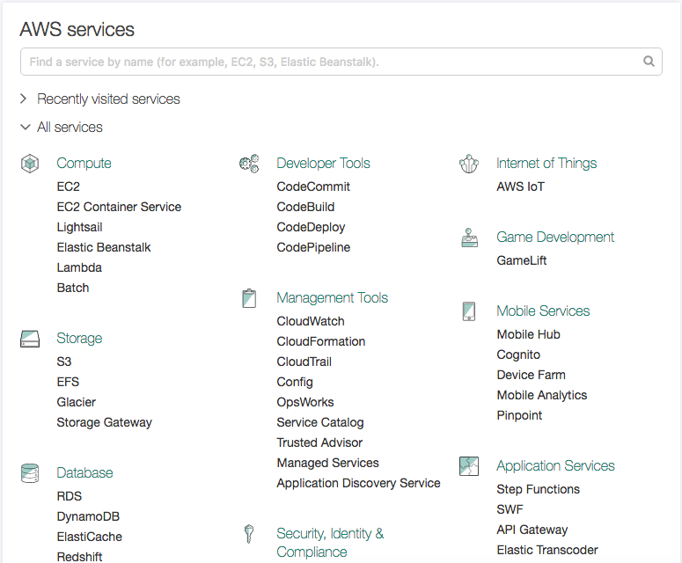
Getting an AWS Server
Go to http://aws.amazon.com/
If you don’t have an account already, click [Create an AWS Account]
You’ll go through a bunch of pages here. Fill them all out as needed
Make sure you only select free options (Basic support, no premium stuff, etc.)
Sign into your account
On the AWS Services page, click on [EC2]

Slide 11
Getting an AWS Server
Click on [Launch Instance]
Click [Select] for the Ubuntu Server that has “Free tier eligible” under the logo
Select the t2.micro option that says “Free tier eligible” and click [Review and Launch]
If you’re doing a project that requires a lot of memory (e.g. NLP with Spacy or NLTK, or deep learning with TensorFlow) you’ll likely need t2.medium
Don’t change any settings. Click [Launch]
What all of this is really doing Amazon is setting aside some amount of server resources for you to create and deploy your application. The micro, medium, etc. options determine how large the resources are. More resources are more expensive (as in not free), but necessary if you’re doing a project that requires a lot of compute power. It still shouldn’t be expensive for a month or so while you demo at companies.

Slide 12
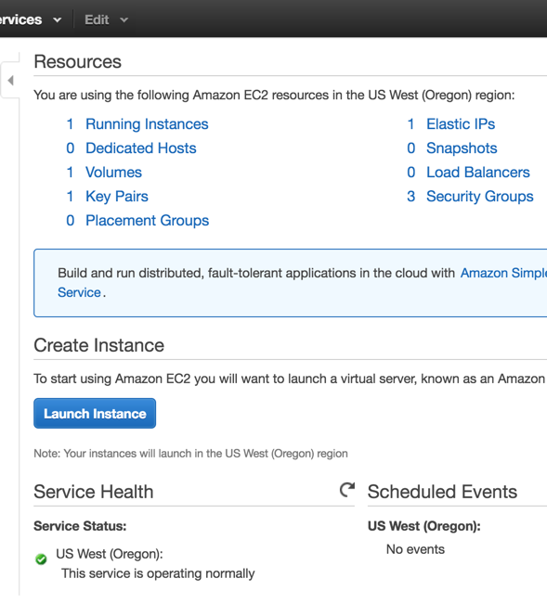
Setting Up the Server
If you’re prompted about a key pair, give it a name (no spaces or special characters, just alphanumeric) and click [Download Key Pair]
Keep this somewhere safe and outside of your application git repository
At the homepage, click [EC2] again
It should say [1 Running Instances] near the top of the page. Click on it.

Slide 13
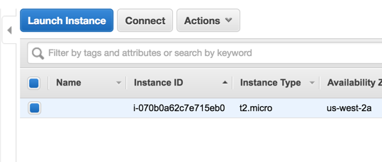
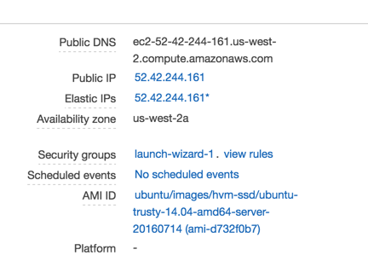
Setting Up the Server
You should see your instance with a bunch of information about it. Click on the [checkbox] to the left
At the bottom of the page will be a bunch of info about your server. The image at the right has a section for elastic IPs. You’ll use this to connect to your server, but don’t worry about it right now. We’ll come back to it

Slide 14
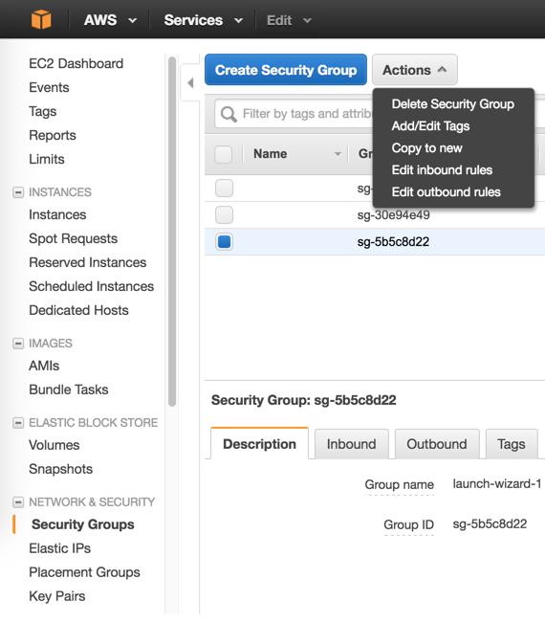
Ugh, Security Groups
To deal with ports and stuff, you need to change a few settings in the security group for your instance. Click on [Security Groups] in the sidebar
Click on your instance
Click [Actions] to get the dropdown menu
Click [Edit inbound rules]

Slide 15
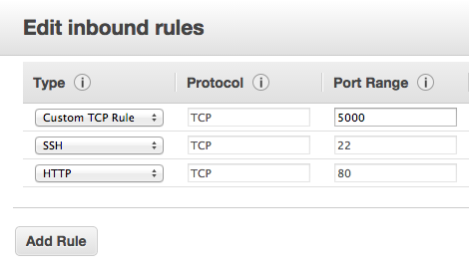
Ugh, Security Groups
Click [Add Rule]
Set the Port Range to 5000
It should say “Custom TCP Rule” in the Type dropdown
There’s another dropdown that should be set to “Anywhere”
If SSH and HTTP rules don’t exist, create them as shown
What all of this is really doing Adding these rules allows you or other people to access your website from non-default ports. All websites listen for traffic on port 80. By default, Flask listens on port 5000.

Slide 16
But what about my domain?

Slide 17
You need to do a few more things for that...
This page has an excellent guide on getting your domain connected to your AWS server. Follow the instructions then come back here. Remember how I said we’d get back to Namecheap?
http://techgenix.com/namecheap-aws-ec2-linux/

Slide 18
That domain thing will take a little while
In the meantime, we can test a few things out and start getting the server ready for your application. There will be a lot of terminal commands here since that’s the only real way to interact with the server.

Slide 19
Getting all of the process magic

Slide 20
Remember that Elastic IP?
So you need to get back to your instance page and the information associated with it
You should write down and save the elastic IP that’s shown since we’ll need it soon

Slide 21
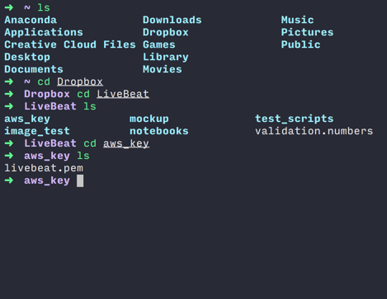
Connecting to your server
Open a terminal window and navigate to where you stored that key pair file you saved. It should have a .pem extension.
If you haven’t used terminal, the command cd stands for “change directory” and lets you move through folders. ls will “list” the files in the directory you’re in. Your navigation might look something like at the right.
If you make a mistake with cd, you can use cd .. to go back one folder.

Slide 22
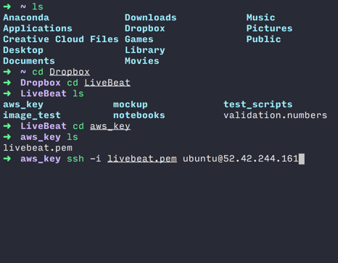
Connecting to your server
Now we’re going to connect to the server via SSH. It stands for “secure shell” and is an authenticated link to your server. That’s why we need the key pair (.pem file)The command to connect is:
$ ssh -i yourkey.pem ubuntu@elasticipaddr
If you used Ubuntu as your AWS instance, the default user is ubuntu. Replace elasticipaddr with the elastic IP you wrote down. Also replace yourkey.pem with the filename of your key pair file.
Now hit Enter. If you get a permissions error, Amazon recommends the command:
$ chmod 400 yourkey.pem

Slide 23
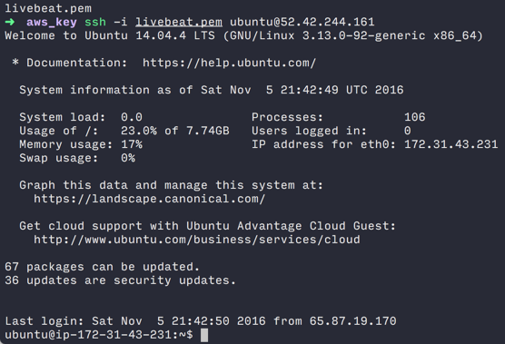
Get your apt-get on
You should now see something like at the right. It’s a readout of the server stats at present. You can interact with the server just like on your own computer. That includes using pip and conda (although you need to install conda first if you want to use it).
To start off with the things we’ll need for the server (since that’s what we’re setting up), run these commands.
$ sudo apt-get update $ sudo apt-get install -y python python-pip nginx

Slide 24
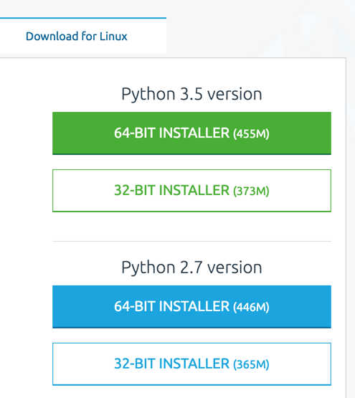
you want/need/gotta have Anaconda?
If you do, you need to install it first. Go to:
https://www.continuum.io/downloads#linux
Figure out which version you want (Python 3.5 or 2.7). The server on AWS should be 64-bit, so select the 64-bit installer. You need to save the address for the one you want. For instance, for the Python 3.5 64-bit installer, I copied:
https://repo.continuum.io/archive/Anaconda3-4.2.0-Linux-x86_64.sh
We’re going to use that address in the terminal window connected to our server to get Anaconda.

Slide 25
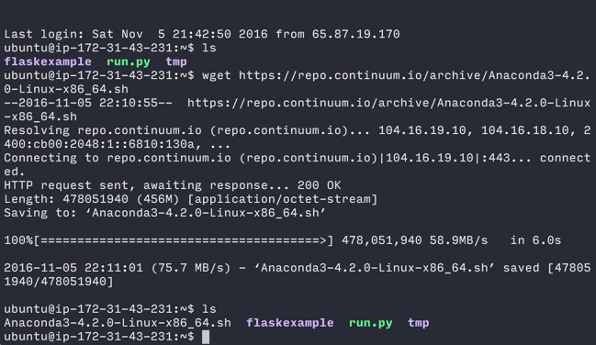
you want/need/gotta have Anaconda?
Go back to that terminal window connected to your server. You’re going to use this command to get the file from the download link.
$ wget http://pathyoucopiedfromanaconda
After you run it, you’ll get something somewhat like what’s at the right. Don’t worry about the other files right now.
That just saved the .sh file. Now we need to run it with this command:
$ bash fileyougot.sh
Replace fileyougot.sh with your file.

Slide 26
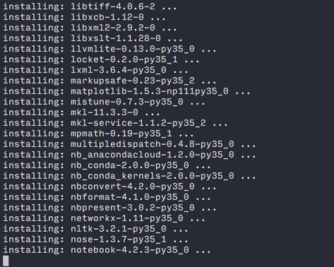
you want/need/gotta have Anaconda?
The installer will run through a bunch of things. When it asks you to read the license agreement, press Q on your keyboard to skip it. It’ll ask if you agree. Just type yes and you’re good to go. When it asks if you want to add the Anaconda install path to .bashrc, type yes.
When you’re back to a normal prompt, make sure you’re in the home directory (the command pwd will tell you your current directory and the command cd with nothing afterward will go back to the home directory) and run this command:
$ source .bashrc

Slide 28
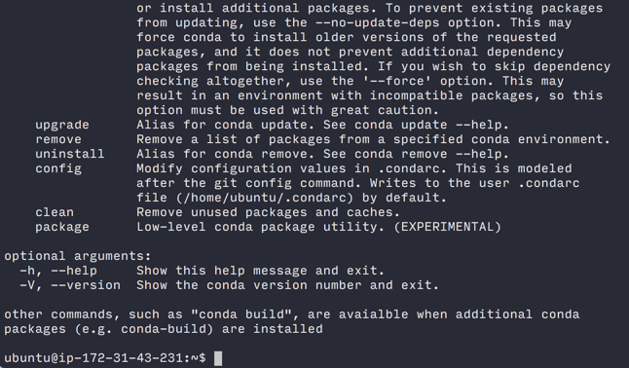
you want/need/gotta have Anaconda?
That command basically makes sure that your terminal connection can see the things that Anaconda installed.
To make sure it went okay, run this command:
$ conda
If it spits out all of the info on how to use the conda command, you’re good to go.

Slide 29
Ain’t no environment like a virtual environment
We just installed a few of the critical pieces needed for the server. NGINX is not written in Python so we needed apt-get to install it. Let’s get the other stuff you’ll need.
I highly recommend (it’s in red and bold because srsly) creating a virtual environment on the server. I’ll leave that decision up to you, but if you need an argument for them, I give you:
http://www.zdnet.com/article/why-choose-a-virtual-environment/
If you have your virtual environment setup with conda or virtualenv in Python, make sure you’re in it now.
‘Cause a virtual environment don’t stop

Slide 30
Magic just for Python
Even though your local computer has Flask and a bunch of other packages that you installed, your server doesn’t, so you need to install those.
I’m going to type the commands with pip, but I expect you can use conda instead without any issue. You need at the very least Flask and Gunicorn, so run:
$ pip install flask gunicorn
Now it’s time to test some stuff.

Slide 31
Testing stuff

Slide 32
Since your domain probably isn’t ready yet
Now that we can start testing, you have a few options for pushing files to your server.
SFTP Client (like Filezilla)
Terminal
Via SCP
Via git + github
For pushing test files (like right now), I recommend using an SFTP client.
If you do use Filezilla, follow the instructions here: https://stackoverflow.com/questions/16744863/connect-to-amazon-ec2-file-directory-using-filezilla-and-sftp
I won’t walk through using the software since they’re all different, but you’ll need to use the .pem file again to connect along with the elastic IP as in the terminal window.
You should get the test files from your program director to put on the server now.

Slide 33
Test files
Once you have the test files and extracted them, you need to push them to your server. Using an SFTP client you can just drag and drop.
From now on, I’m going to assume that the files are on your server and we’ll go from there.

Slide 34

The Starter Package
To try and save you time, I’ve created a barebones frontend and backend that takes a text input and has a function to handle it. It’s ready to go, and I recommend using it for your own app. Feel free to add, edit, break, and fix whatever you want. The file structure is what it should be too!
If you want to use it, download (or git clone) from my Github repository here:
https://github.com/rwinslow/flaskapp

Slide 35
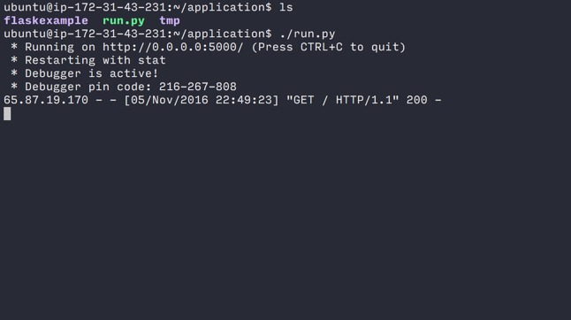
Flask and You
SSH back into your server in a terminal window and cd into the folder application that should be there.
Just like on your local computer, run:
$ ./run.py
You should see something like at the right. Now open your browser and go to your server. If your domain isn’t ready yet, you’ll need to use the elastic IP. One important note, you’ll need to use port 5000 to access it. It’s the Flask default. The address I used looks like:
http://52.42.244.161:5000

Slide 36

Flask and You
If everything is running correctly, you should get a page that looks like what you see at the right. It’s a framework to start from. You can replace the frontend with a Bootstrap template or edit it as you see fit. The Flask app, though, has a few important features:
It runs
The Flask app directory is organized correctly
It takes a query as input, gives it to another page to do processing then outputs the result
This will help you deal with migrating your own app or starting from scratch.

Slide 37
What if I want to check my domain?
To see if your domain is pointing to the right address and working fine:
Make sure Flask is running in a terminal window that’s connected to your server
In your browser, go to your address but add :5000 after it
For example: http://mysite.com:5000
If your domain is pointed correctly, you should see the exact same thing as when you typed in the ip address

Slide 38
It’s not pronounced N-Jinx*
*It’s pronounced “Engine X”

Slide 39
Whadabout NGINX?
Now that our site is up and running with Flask’s lightweight debug server, we’re gonna get the real server stuff up and running. NGINX is going to be our focus right now.
Let’s start by making sure NGINX is running. Run:
$ sudo /etc/init.d/nginx start
If it’s already running, no big deal.
Note
NGINX has two critical folders that contain the configuration files for your website or websites:
/etc/nginx/sites-available/
/etc/nginx/sites-enabled/
sites-available holds the config files of all sites that are present on the server
sites-enabled holds soft links (I’ll explain later) to the sites that are actually active and accessible.

Slide 40
Configuration Time
In that terminal window connected to your server, we’re gonna have to change a few things to NGINX’s site configuration files. Go ahead and run these commands exactly as shown:
$ sudo rm /etc/nginx/sites-enabled/default $ sudo touch /etc/nginx/sites-available/application $ sudo ln -s /etc/nginx/sites-available/application /etc/nginx/sites-enabled/application
Note
sudo is a command that can ruin your day if you’re not careful. It stands for “superuser do” and gives you total control. If I’m having you use that command, it’s required, just make sure to follow instructions exactly.
It’s very important that you remove all other files in /etc/nginx/sites-enabled. There should be exactly one file in there; the one that tells NGINX how to direct traffic to your application.

Slide 41
What did I just do?
So let’s walk through what those commands did.
First, there’s a soft link to a file, called default, in sites-enabled. A soft link is just like a shortcut (on Windows) or alias (on Mac). It lets you access the actual file without making a copy of it or moving it anywhere. The real default file is in sites-available and is just a reference. If we leave the soft link in sites-enabled, it will mess up our main application so we’re deleting it with the rm command.
Next, we’re using the command touch to create a text file called application in sites-available. It’s just a placeholder now that we’ll fill out in a bit.
Finally, we’re creating our own soft link to application in the sites-enabled folder. This ensures NGINX can see the file application when it checks for which sites it should actually be serving.

Slide 42
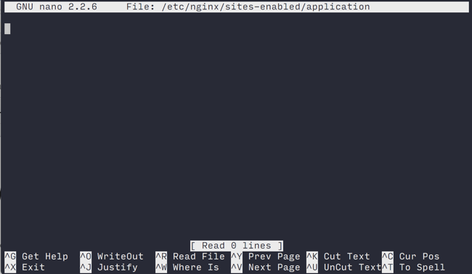
But application is empty...
Yup, so we’re going to fill it with the right configuration for our application. Run this command all on one line to begin editing the file:
$ sudo nano /etc/nginx/sites-enabled/application
I’m recommending you use nano because it has familiar keyboard shortcuts. You can use vim, emacs, or whatever else you want, but nano has a much shallower learning curve than the other two.
You should see something like what’s at the right.

Slide 43
Filling in the application config file
Type in the following configuration exactly as shown below. When you’re done, press CTRL+O (yes, CTRL even on Mac) then Enter to save the file. Press CTRL+X after to exit. As long as you didn’t change any directory names, this will work.
Important notes: 1. Make sure your /static alias has NO trailing slash! 2. Do NOT copy and paste this! It will likely have invisible characters and cause problems with NGINX. Type it all manually.
server { location / { proxy_pass http://localhost:8000; proxy_set_header Host $host; proxy_set_header X-Real-IP $remote_addr; } location /static { alias /home/ubuntu/application/flaskexample/static; } }

Slide 44
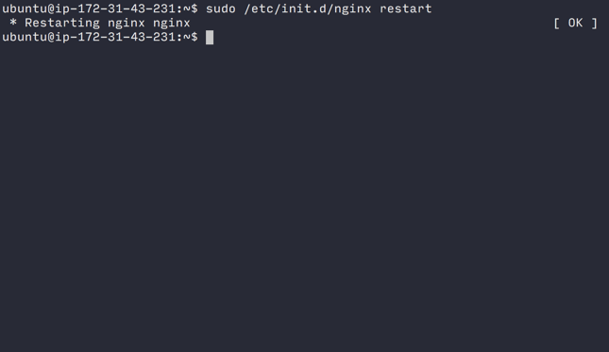
And that? What’d it do? And what now?
We’re telling NGINX exactly where the static files are located and where to direct incoming traffic. We gave it a few variable names (they have the $ in front of the word) that are set when we run Gunicorn (we’ll talk about that in a minute).
Now we need to restart NGINX so it sees the changes we made. Run this:
$ sudo /etc/init.d/nginx restart
If there are no errors, you should get a status that says [ OK ]

Slide 45
It stands for green unicorn
*And it’s pronounced G-Unicorn

Slide 46
Almost there
We have all of the main pieces of the puzzle ready to go. Now comes the last part.
NGINX will take the traffic from the outside world and send it to whatever process on the localhost (your server) that is listening on port 8000. That will be Gunicorn. The reason we don’t want to use Flask’s lightweight debug server is because it can’t handle multiple users and is very prone to crashing. It’s really only designed for one person to do debugging. That’s it. Gunicorn will fix all of those problems.
If you want more detail on why we’re using NGINX + Gunicorn with Flask, read this:
http://stackoverflow.com/questions/20766684/what-benefit-is-added-by-using-gunicorn-nginx-flask

Slide 47
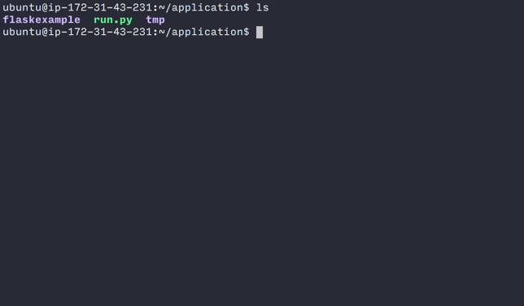
Running Gunicorn
We don’t need to deal with any config files anymore, we just run Gunicorn. So navigate back to your home directory and the folder application. You should be inside of application now. It should look something like what’s at the right.
Now we’re going to run Gunicorn with this command:
$ gunicorn flaskexample:app

Slide 48
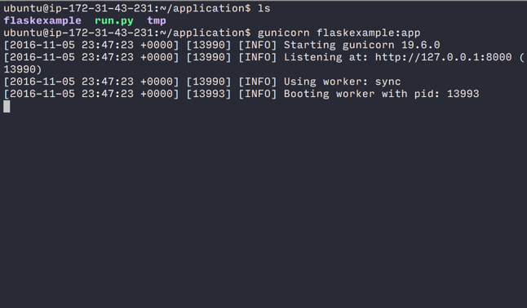
Running Gunicorn
You should get an output like at the right. Go to your site (with the elastic IP or the domain name if it’s working) without the :5000 at the end. You should get the example application we’ve been playing with.
Once you’ve confirmed it’s all good, go back to terminal and kill Gunicorn by pressing CTRL+C. It’s running as a foreground process and we need to be a background process. If we don’t make it a background process, our site will go down when we logout.

Slide 49
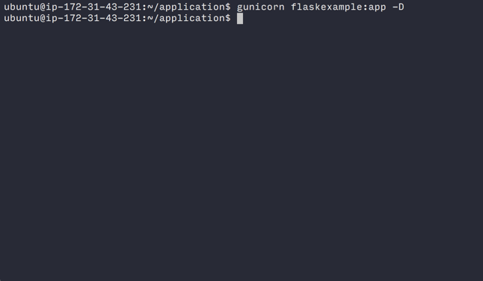
Running Gunicorn
Setting it up as a background process is super easy. You only need to make one change to the Gunicorn command. Run this:
$ gunicorn flaskexample:app -D
You won’t get any output now because it’s running in the background. Check the site is still running in your browser and you can close your terminal window now.
If you want to kill Gunicorn to make changes to your site, in the terminal window just run:
$ pkill gunicorn

Slide 50

We’re done!

Slide 51
Epilogue

Slide 52
Supervisord and Process Managers
Supervisord and other process managers are great if you need your site to come back online in case of restarts or if processes crash. You don’t need to implement it for your Insight project if you don’t want to. If the site goes down or has to restart, you will have to SSH back into your server and restart Gunicorn. Honestly, if your site crashes and you need to do that, it’s probably a good thing for you to check what’s going on anyway.

Slide 53
Databases
This walkthrough omitted dealing with databases. If you want to run Postgres or another database for your site, you’ll need to install all of the necessary components just like we did with NGINX, Gunicorn and Flask.
Digital Ocean has a great tutorial on getting Postgresql setup on an Ubuntu server:
https://www.digitalocean.com/community/tutorials/how-to-install-and-use-postgresql-on-ubuntu-14-04
You’ll need psycopg2 and sqlalchemy to interface with the database from within Flask. I recommend looking around for tutorials on doing that. They do not have to be AWS specific.

Slide 54
Oh Snap. Plz Hlp.

Slide 55
NGINX + Site Availability
My site isn’t showing up!
Check to make sure you deleted the default soft link in /etc/nginx/sites-enabled/
Are there any typos in your config files?
Is the absolute path for /static/ set correctly in the config file?
Did you set the security group ports correctly?
Is your domain name done working its way through the international DNS servers?
Did you input the correct nameservers at Namecheap?
Did you remove the periods at the end of the nameserver strings when you input them?

Slide 56
Gunicorn
I get errors!
The structure of the command for running your app is:
$ gunicorn foldername:appvariablename
You need to be able to see the folder, not in the folder to run it. The appvariablename is defined in your views.py file.

Slide 57
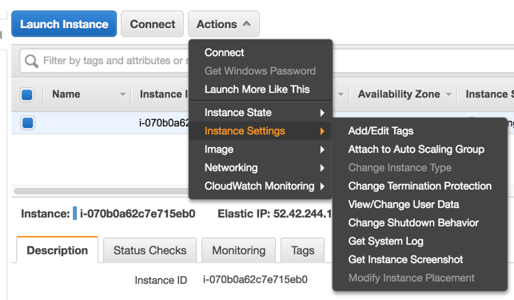
Memory Issues
My application just times out, what’s up with that?
You may be running out of memory on your AWS instance. You need to:
Go into your EC2 Dashboard
Select your instance
Click [Actions]
Go to Instance State and click [Stop]
Go to Instance Settings and click [Change Instance Type]
Select a larger instance type than what you currently have
After it’s done updating, go to Instance State and click [Start]

Slide 58
Jargon

Slide 59
Servers
WSGI - Web server gateway interface. It’s a class of processes that bridge the gap between application processes (like Flask) and heavier server processes (like NGINX). Gunicorn is a WSGI.
Port 80 - This is the standard port around the internet that all traffic listens on. Because it’s the default, you don’t have to type it in web addresses. It’s implicit.
Port 8000 - Default port that Gunicorn listens on
Port 5000 - Default port Flask listens on
apt-get - Ubuntu’s application repository. Runs from the command line.

